Slide 1
Note Taking

Slide 2
Good notes are essential for success!

Slide 3
Different note taking techniques
1. Outline format technique
This is the ‘traditional’ format of indented lists.
An agenda for a meeting may be prepared using this structured format and notes taken for the meeting may follow this structure.
An example of this technique follows…

Slide 4
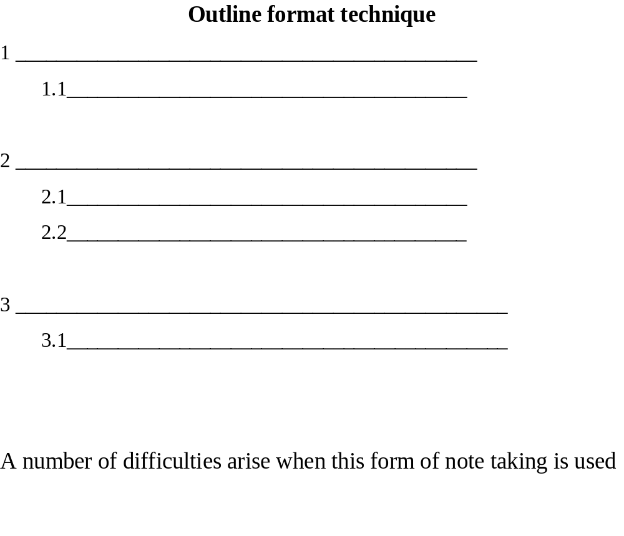

Slide 5
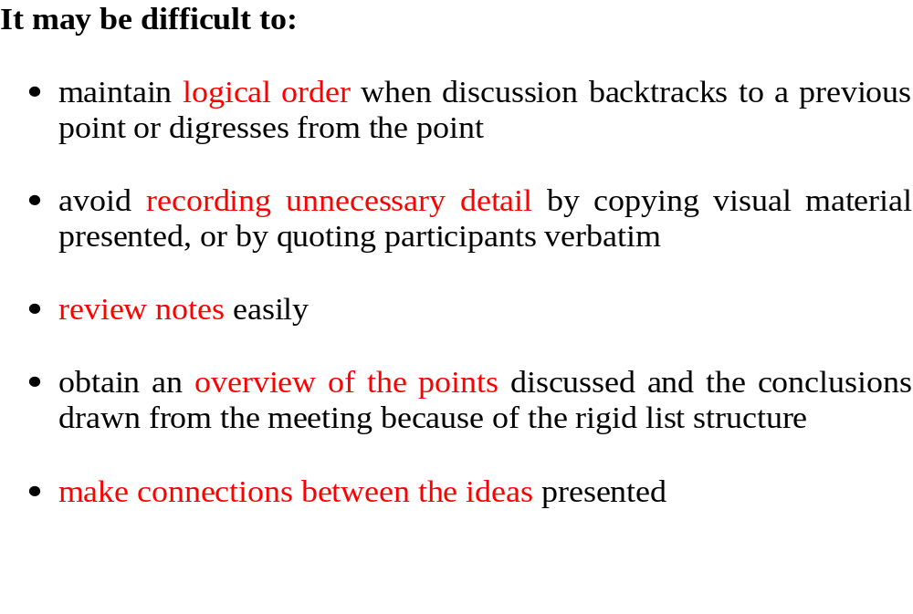


Slide 6
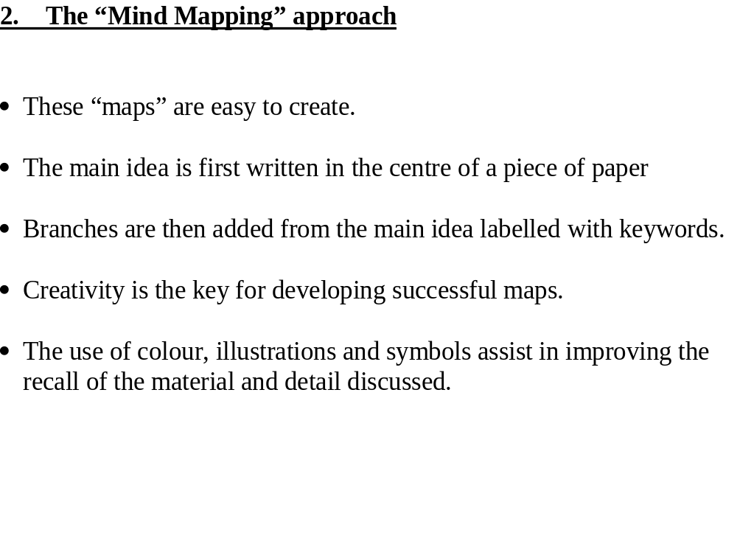

Slide 7
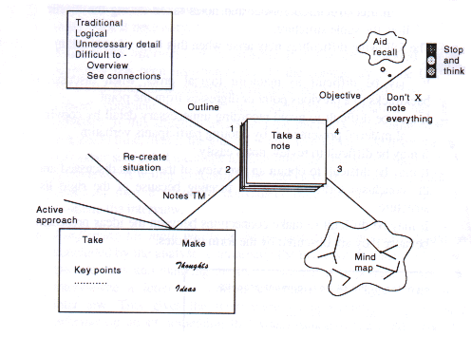

Slide 8
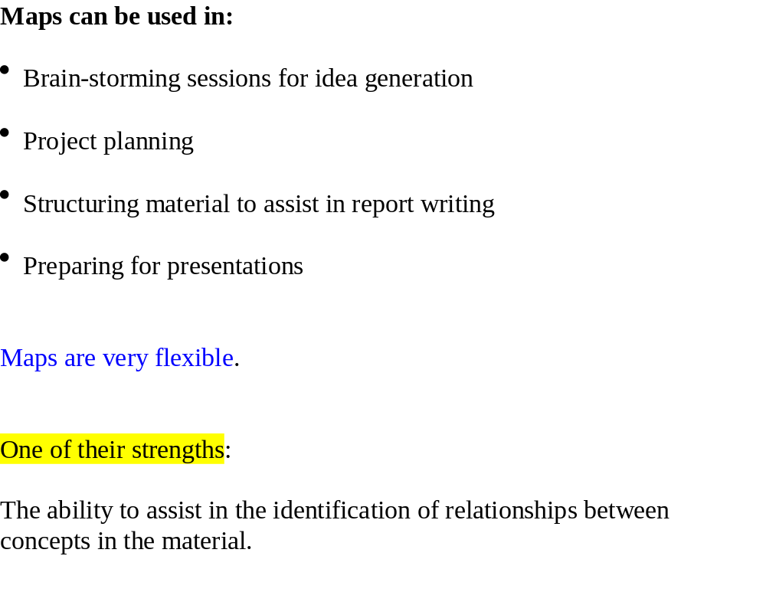

Slide 9
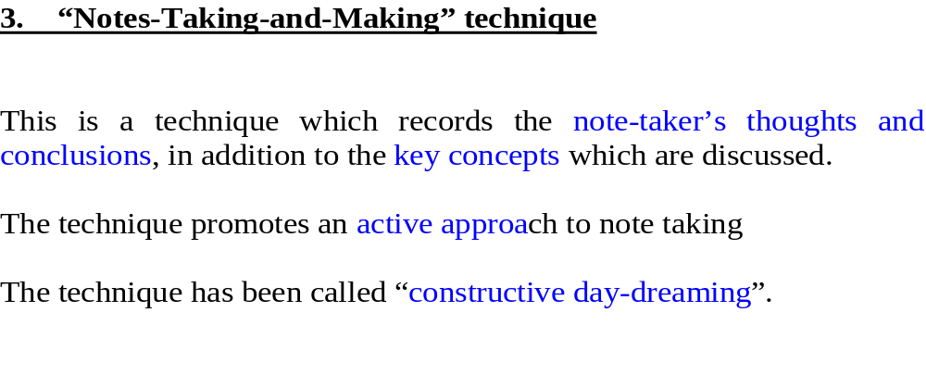

Slide 10
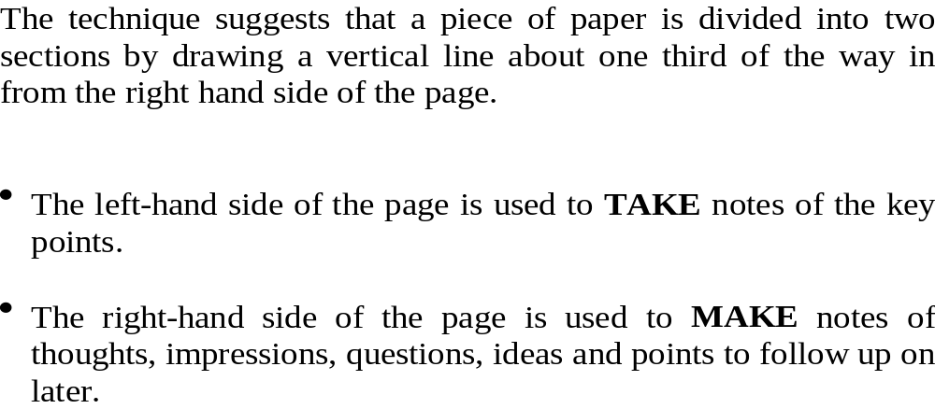

Slide 11
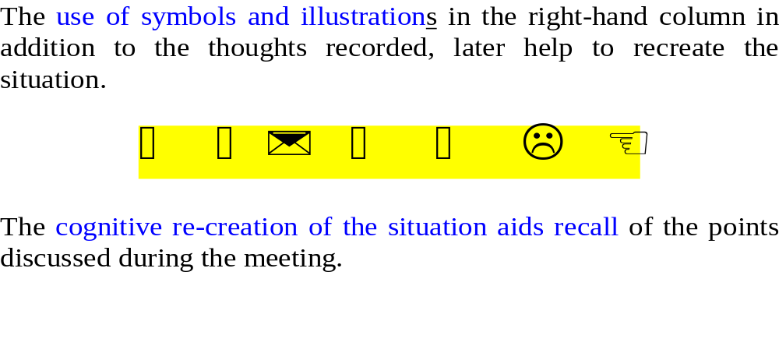

Slide 12
This technique is particularly useful in meetings and interviews where
the manner in which the words were spoken
is as important as
the actual words themselves.
For example, expressions of
uncertainty
anxiety
apprehensiveness
concern
…could be important indicators.
You need to note these expressions and deal with their implications.

Slide 13
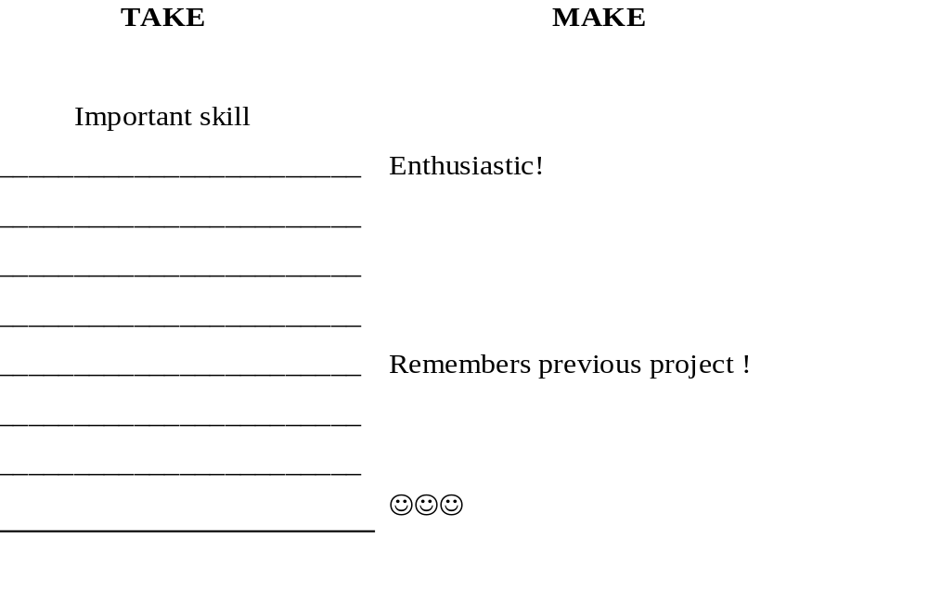

Slide 14


Poor, incomplete and incomprehensible notes are worthless.
Poor, incomplete and incomprehensible notes are worthless.
Poor, incomplete and incomprehensible notes are worthless.

Slide 15
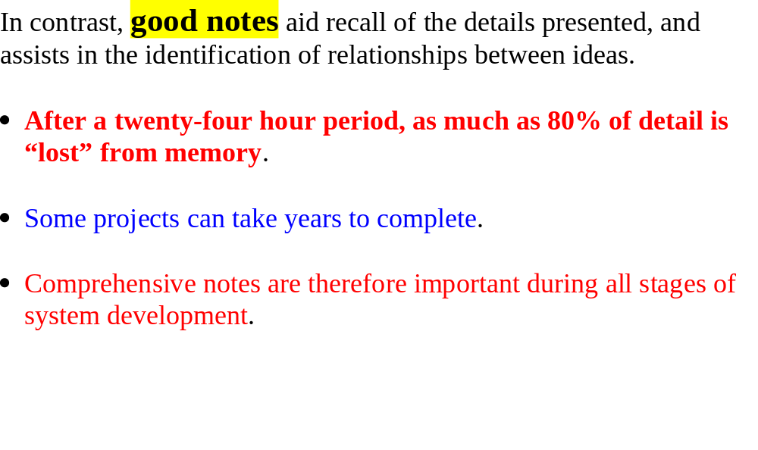

Slide 16
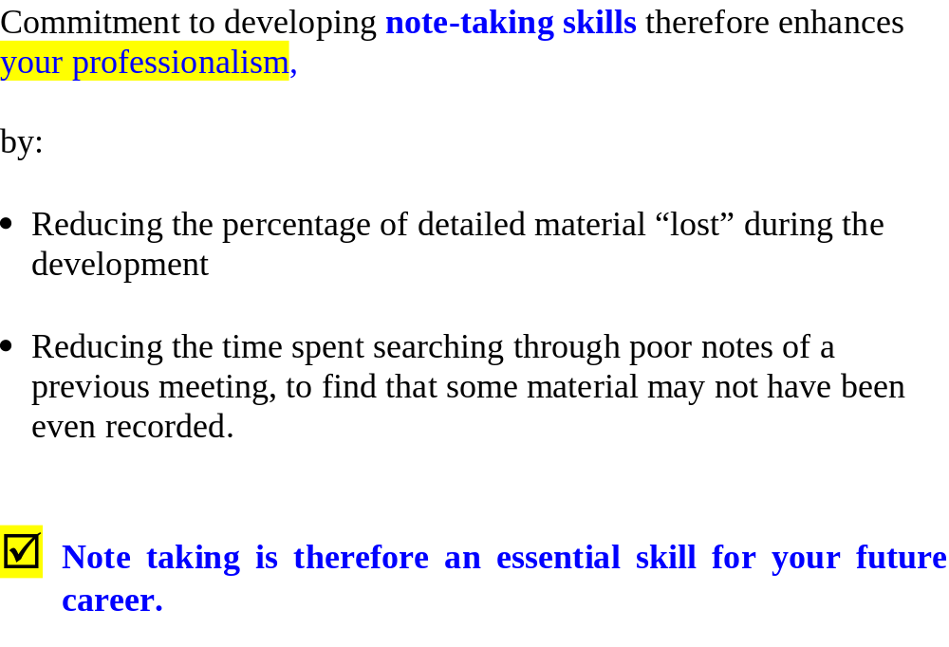

Slide 17
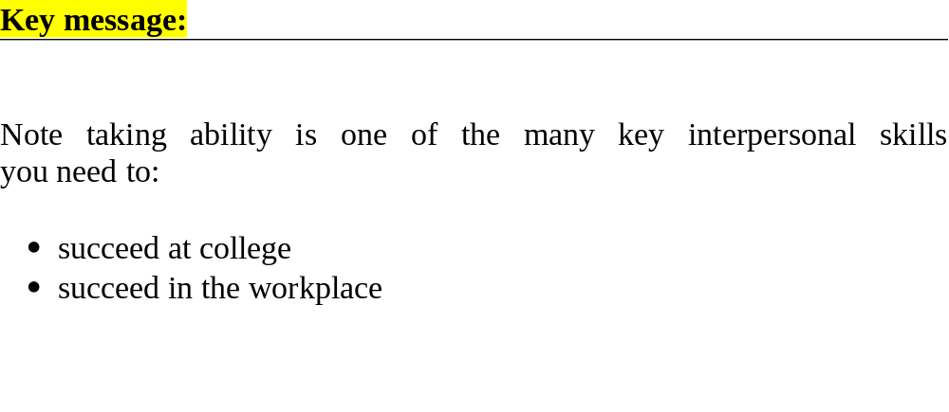

Slide 18
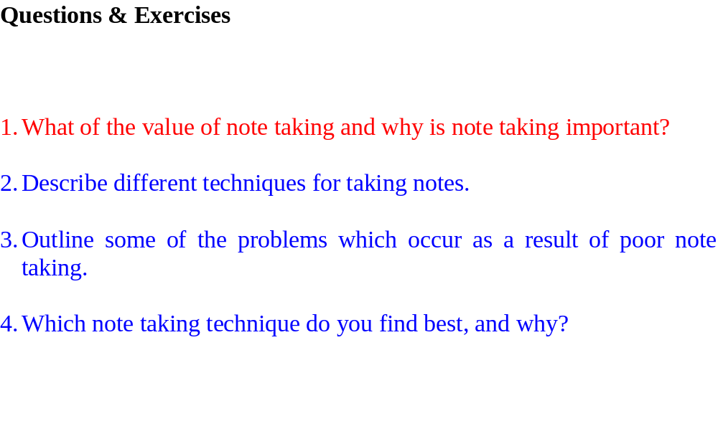
Answers in your Communications Notebook !

